Slide 1

Project Integration Management

Slide 2
The Key to Overall Project Success: Good Project Integration Management
Project managers must coordinate all of the other knowledge areas throughout a project’s life cycle
Many new project managers have trouble looking at the “big picture” and want to focus on too many details
Project integration management is not the same thing as software integration

Slide 3
Project Integration Management Processes, Part 1
Developing the project charter involves working with stakeholders to create the document that formally authorizes a project—the charter.
Developing the project management plan involves coordinating all planning efforts to create a consistent, coherent document—the project management plan.
Directing and managing project work involves carrying out the project management plan by performing the activities included in it.

Slide 4
Project Integration Management Processes, Part 2
Monitoring and controlling project work involves overseeing activities to meet the performance objectives of the project
Performing integrated change control involves identifying, evaluating, and managing changes throughout the project life cycle.
Closing the project or phase involves finalizing all activities to formally close the project or phase.

Slide 5
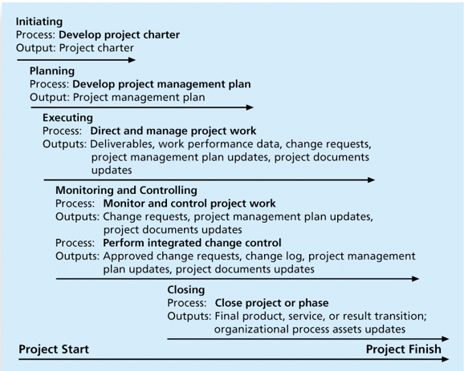
Project Integration Management Summary

Slide 6
Strategic Planning and Project Selection
Strategic planning involves determining long-term objectives, predicting future trends, and projecting the need for new products and services
Organizations often perform a SWOT analysis
analyzing Strengths, Weaknesses, Opportunities, and Threats
As part of strategic planning, organizations
identify potential projects
use realistic methods to select which projects to work on
formalize project initiation by issuing a project charter

Slide 7
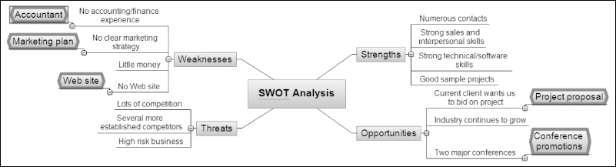
Mind Map of a SWOT Analysis to Help Identify Potential Projects

Slide 8
Methods for Selecting Projects
There are usually more projects than available time and resources to implement them
Methods for selecting projects include:
Focusing on broad organizational needs
Categorizing information technology projects
Performing net present value or other financial analyses
Using a weighted scoring model
Implementing a balanced scorecard

Slide 9
Focusing on Broad Organizational Needs
It is often difficult to provide strong justification for many IT projects, but everyone agrees they have a high value
Three important criteria for projects:
There is a need for the project
There are funds available
There’s a strong will to make the project succeed

Slide 10
Categorizing IT Projects
One categorization is whether the project addresses
a problem (solve an existing issue that negatively affects)
an opportunity (take advantage of new technologies, trends, or business chances to improve competitiveness or growth)
a directive (initiated because of a mandate, regulation, or top-level management order, not necessarily because of a problem or opportunity)
Another categorization is how long it will take to do and when it is needed
Another is the overall priority of the project

Slide 11
Financial Analysis of Projects
Financial considerations are often an important consideration in selecting projects
Three primary methods for determining the projected financial value of projects:
Net present value (NPV) analysis
Return on investment (ROI)
Payback analysis

Slide 12
Net Present Value Analysis
Net present value (NPV) analysis is a method of calculating the expected net monetary gain or loss from a project by discounting all expected future cash inflows and outflows to the present point in time
It is a financial metric used to evaluate the profitability of an investment, project, or decision by comparing the value of expected future cash inflows to the initial investment cost, after adjusting for the time value of money.
Projects with a positive NPV should be considered if financial value is a key criterion
The higher the NPV, the better

Slide 13
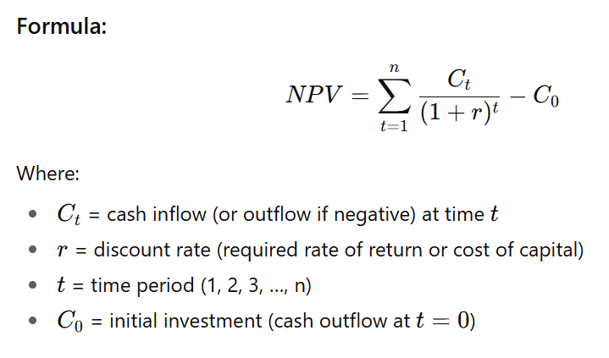
Net Present Value Analysis

Slide 14
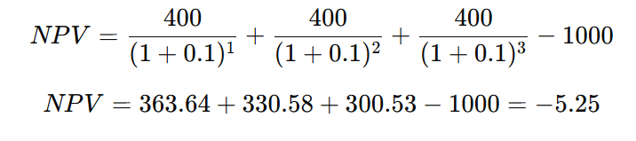
Net Present Value Analysis (Example)
Suppose you invest $1,000 today in a project that will return $400 per year for 3 years. The discount rate is 10%.

Slide 15
Net Present Value Analysis (Example)
Project R requires an initial investment of $45,000 and expects to generate $30,000 annually for two years, with an 8% discount rate. To estimate the NPV, the company that wants to invest in Project R finds the individual NPV of both cash flows and adds the results. Then, it deducts the initial investment from the sum of the NPVs.
NPV of Project R = [$30,000 / (1+0.08)^1] + [$30,000 / (1+0.08)^2] - $45,000 NPV = ($27,777.78 + $25,720.17) - $45,000 = $8,497.95

Slide 16
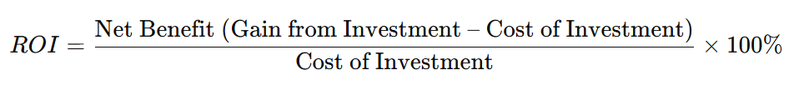
Return on Investment
Return on investment (ROI) is a performance measure that tells you how much profit or benefit you gain from an investment compared to its cost.
It is calculated by subtracting the project costs from the benefits and then dividing by the costs
The higher the ROI, the better
Many organizations have a required rate of return or minimum acceptable rate of return on investment for projects
Internal rate of return (IRR) can by calculated by finding the discount rate that makes the NPV equal to zero

Slide 17
Return on Investment (Example)
You invest $10,000 in a project.
The project generates $15,000 in benefits (savings or revenue).
Net benefit = 15,000 – 10,000 = $5,000
ROI=(5000​/10000)×100% = 50%

Slide 18
Payback Analysis
Another important financial consideration is payback analysis
“How many years (or months) will it take until I get my money back?”
The payback period is the amount of time it will take to recoup, in the form of net cash inflows, the total dollars invested in a project
Payback occurs when the net cumulative discounted benefits equal the costs
Many organizations want IT projects to have a fairly short payback period

Slide 19
Weighted Scoring Model
A weighted scoring model is a tool that provides a systematic process for selecting projects based on many criteria
Identify criteria important to the project selection process
Assign weights (percentages) to each criterion so they add up to 100%
Assign scores to each criterion for each project
Multiply the scores by the weights and get the total weighted scores
The higher the weighted score, the better

Slide 20
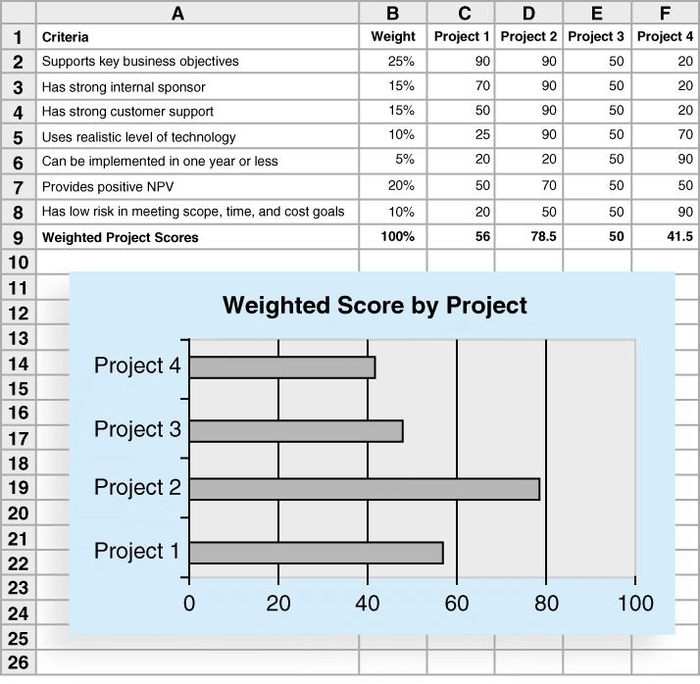
Sample Weighted Scoring Model for Project Selection
Empty cell | A | B | C | D | E | F
1 | Criteria | Weight | Project 1 | Project 2 | Project 3 | Project 4
2 | Supports key business objectives | 25% | 90 | 90 | 50 | 20
3 | Has strong internal sponsor | 15% | 70 | 90 | 50 | 20
4 | Has strong customer support | 15% | 50 | 90 | 50 | 20
5 | Uses realistic level of technology | 10% | 25 | 90 | 50 | 70
6 | Can be implemented in one year or less | 5% | 20 | 20 | 50 | 90
7 | Provides positive NPV | 20% | 50 | 70 | 50 | 50
8 | Has low risk in meeting scope, time, and cost goals | 10% | 20 | 50 | 50 | 90
9 | Weighted Project Scores | 100% | 56 | 78.5 | 50 | 41.5

Slide 21
Implementing a Balanced Scorecard
Drs. Robert Kaplan and David Norton developed this approach to help select and manage projects that align with business strategy
The Balanced Scorecard is a framework that tracks organizational performance across financial, customer, internal process, and learning/growth perspectives—ensuring balance between short-term results and long-term sustainability.
A framework that measures success across Financial, Customer, Internal Process, and Learning & Growth perspectives, instead of looking only at money.

Slide 22
Implementing a Balanced Scorecard
Organizations often have many project proposals but limited resources. The Balanced Scorecard helps by checking:
Does the project align with the strategy?
Does it contribute across all four perspectives (not just financial)?
This ensures that the chosen projects are not only profitable but also support customer satisfaction, internal efficiency, and long-term growth.

Slide 23
How Balanced Scorecard Guides Project Selection
Financial Perspective
Does the project increase revenue, reduce costs, or improve ROI?
Example: A project that automates billing may save costs and improve margins.
Customer Perspective
Will it improve customer experience, satisfaction, or market share?
Example: A project introducing faster delivery improves customer satisfaction.
Internal Process Perspective
Does it streamline operations, reduce defects, or speed up processes?
Example: A supply chain optimization project reduces delays and waste.
Learning & Growth Perspective
Does it enhance employee skills, innovation, or organizational capabilities?
Example: A digital training platform project improves staff knowledge and adaptability.

Slide 24
Developing a Project Charter
After deciding what project to work on, it is important to let the rest of the organization know
A project charter is a document that formally recognizes the existence of a project and provides direction on the project’s objectives and management
Key project stakeholders should sign a project charter to acknowledge agreement on the need and intent of the project; a signed charter is a key output of project integration management

Slide 25
Inputs for Developing a Project Charter
A project statement of work
A business case
Agreements
Enterprise environmental factors
Organizational process assets, which include formal and informal plans, policies, procedures, guidelines, information systems, financial systems, management systems, lessons learned, and historical information

Slide 26
Project Charter for the DNA-Sequencing Instrument Completion Project
Project Title: DNA-Sequencing Instrument Completion Project Date of Authorization: February 1 Project Start Date: February 1 Projected Finish Date: November 1
Key Schedule Milestones: Complete first version of the software by June 1 Complete production version of the software by November 1
Budget Information: The firm has allocated $1.5 million for this project, and more funds are available if needed. The majority of costs for this project will be internal labor. All hardware will be outsourced.
Project Manager: Nick Carson, (650) 949-0707, ncarson@dnaconsulting.com
Project Objectives: The DNA-sequencing instrument project has been underway for three years. It is a crucial project for our company. This is the first charter for the project, and the objective is to complete the first version of the software for the instrument in four months and a production version in nine months.
Main Project Success Criteria: The software must meet all written specifications, be thoroughly tested, and be completed on time. The CEO will formally approve the project with advice from other key stakeholders.

Slide 27
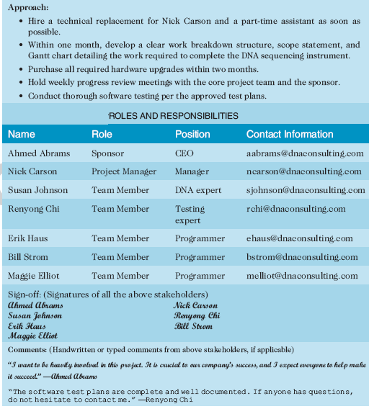
Project Charter (cont..)
Name | Role | Position | Contact Information
Ahmed Abrams | Sponsor | CEO | aabrams@dnaconsulting.com
Nick Carson | Project Manager | Manager | ncarson@dnaconsulting.com
Susan Johnson | Team Member | DNA expert | sjohnson@dnaconsulting.com
Renyong Chi | Team Member | Testing expert | rchi@dnaconsulting.com
Erik Haus | Team Member | Programmer | ehaus@dnaconsulting.com
Bill Strom | Team Member | Programmer | bstrom@dnaconsulting.com
Maggie Elliot | Team Member | Programmer | melliot@dnaconsulting.com

Slide 28
Developing a Project Management Plan
A project management plan is a document used to coordinate all project planning documents and help guide a project’s execution and control
Plans created in the other knowledge areas are subsidiary parts of the overall project management plan

Slide 29
Common Elements of a Project Management Plan
Introduction or overview of the project
Description of how the project is organized
Management and technical processes used on the project
Work to be done, schedule, and budget information

Slide 30
Table 4-2. Sample Contents for a Software Project Management Plan (SPMP)
MAJOR SECTION HEADINGS | SECTION TOPICS
Overview | Purpose, scope, and objectives; assumptions and constraints; project deliverables; schedule and budget summary; evolution of the plan
Project Organization | External interfaces; internal structure; roles and Responsibilities
Managerial Process Plan | Start-up plans (estimation, staffing, resource acquisition; and project staff training plans); work plan (work activities, schedule, resource, and budget allocation); control plan; risk management plan; closeout plan
Technical Process Plans | Process model; methods, tools, and techniques; infrastructure Plan; product acceptance plan
Supporting Process Plans | Configuration management plan; verification and validation plan; documentation plan; quality assurance plan; reviews And audits; problem resolution plan; subcontractor manage- ment plan; process improvement plan
IEEE Standard 1058-1998. | Empty cell

Slide 31
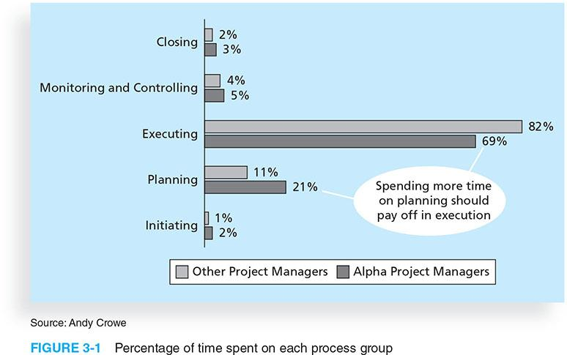
Directing and Managing Project Work
Involves managing and performing the work described in the project management plan
The majority of time and money is usually spent on execution
The application area of the project directly affects project execution because the products of the project are produced during execution

Slide 32
Coordinating Planning and Execution
Project planning and execution are intertwined and inseparable activities
Those who will do the work should help to plan the work
Project managers must solicit input from the team to develop realistic plans

Slide 33
Providing Leadership and a Supportive Culture
Project managers must lead by example to demonstrate the importance of creating and then following good project plans
Organizational culture can help project execution by
providing guidelines and templates
tracking performance based on plans
Project managers may still need to break the rules to meet project goals, and senior managers must support those actions

Slide 34
Project Execution Tools and Techniques
Expert judgment: Experts can help project managers and their teams make many decisions related to project execution
Meetings: Meetings allow people to develop relationships, pick up on important body language or tone of voice, and have a dialogue to help resolve problems.
Project management information systems: There are hundreds of project management software products available on the market today, and many organizations are moving toward powerful enterprise project management systems that are accessible via the Internet
See the What Went Right? example of Kuala Lumpur’s Integrated Transport Information System on p. 169

Slide 35
Monitoring and Controlling Project Work
Changes are inevitable on most projects, so it’s important to develop and follow a process to monitor and control changes
Monitoring project work includes collecting, measuring, and disseminating performance information
A baseline is the approved project management plan plus approved changes

Slide 36
Performing Integrated Change Control
Three main objectives are:
Influencing the factors that create changes to ensure that changes are beneficial
Determining that a change has occurred
Managing actual changes as they occur

Slide 37
Change Control on Information Technology Projects
Former view: The project team should strive to do exactly what was planned on time and within budget
Problem: Stakeholders rarely agreed up-front on the project scope, and time and cost estimates were inaccurate
Modern view: Project management is a process of constant communication and negotiation
Solution: Changes are often beneficial, and the project team should plan for them

Slide 38
Change Control System
A change control system is a formal, documented process that describes when and how official project documents and work may be changed
Describes who is authorized to make changes and how to make them

Slide 39
Change Control Board (CCB)
A change control board is a formal group of people responsible for approving or rejecting changes on a project
CCBs provide guidelines for preparing change requests, evaluate change requests, and manage the implementation of approved changes
Includes stakeholders from the entire organization

Slide 40
Making Timely Changes
Some CCBs only meet occasionally, so it may take too long for changes to occur
Some organizations have policies in place for time-sensitive changes
“48-hour policy” allows project team members to make decisions, then they have 48 hours to reverse the decision pending senior management approval
Delegate changes to the lowest level possible, but keep everyone informed of changes

Slide 41
Configuration Management
Configuration management ensures that the descriptions of the project’s products are correct and complete
Involves identifying and controlling the functional and physical design characteristics of products and their support documentation
Configuration management specialists identify and document configuration requirements, control changes, record and report changes, and audit the products to verify conformance to requirements
See www.icmhq.com for more information

Slide 42
Closing Projects or Phases
To close a project or phase, you must finalize all activities and transfer the completed or cancelled work to the appropriate people
Main outputs include
Final product, service, or result transition
Organizational process asset updates

Slide 43
Using Software to Assist in Project Integration Management
Several types of software can be used to assist in project integration management
Documents can be created with word processing software
Presentations are created with presentation software
Tracking can be done with spreadsheets or databases
Communication software can facilitate communications
Project management software can pull everything together and show detailed and summarized information

Slide 44
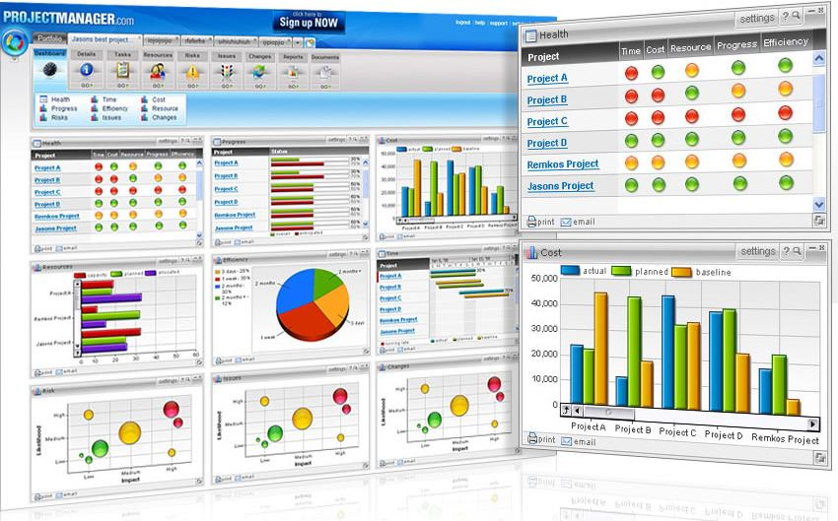
Sample Portfolio Management Software Screen
Source: www.projectmanager.com

Slide 45
Chapter Summary
Project integration management involves coordinating all of the other knowledge areas throughout a project’s life cycle
Main processes include
Develop the project charter
Develop the project management plan
Direct and manage project execution
Monitor and control project work
Perform integrated change control
Close the project or phase

